Slide 1
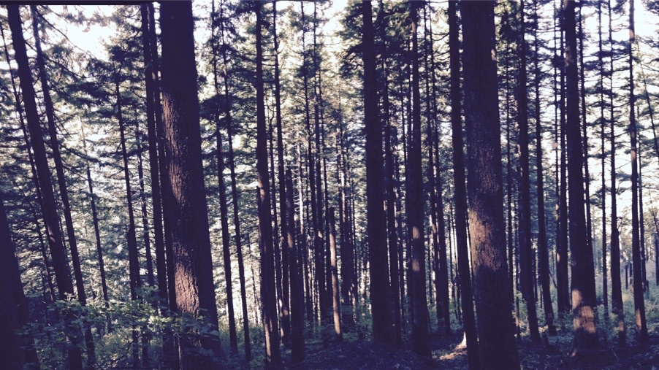
Photosynthetic acclimation to global change: improved understanding for more reliable predictions
Nick Smith
Texas Tech University
nick.smith@ttu.edu

Slide 2



Thank you
ESA for selecting me as an Early Career Fellow
My amazing lab and scientific network
Lizz Waring and Evan Perkowski (ECF nominators)

Slide 3
Learning from mentees to better understand your science and your self
Nick Smith
Texas Tech University
nick.smith@ttu.edu

Slide 4
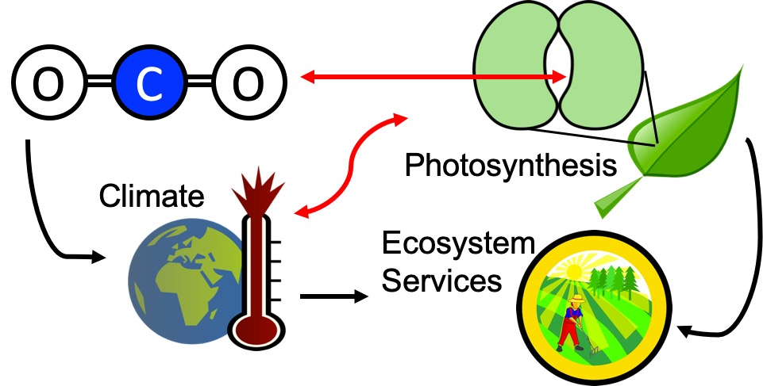
Our lab examines photosynthesis as a regulator of global change impacts on ecosystem services

Slide 5
Photosynthesis is a dynamic process that is likely to be impacted by global change
MODIS, NASA

Slide 6
But predictions are uncertain!
Friedlingstein et al. (2014)

Slide 7
But predictions are uncertain!
Future model uncertainty (14 Pg) > current fossil fuel emissions (9.5 Pg)
Friedlingstein et al. (2014)

Slide 8
This uncertainty is driven by uncertainty in photosynthesis
Friedlingstein et al. (2014)
Keenan et al. (in review)

Slide 9
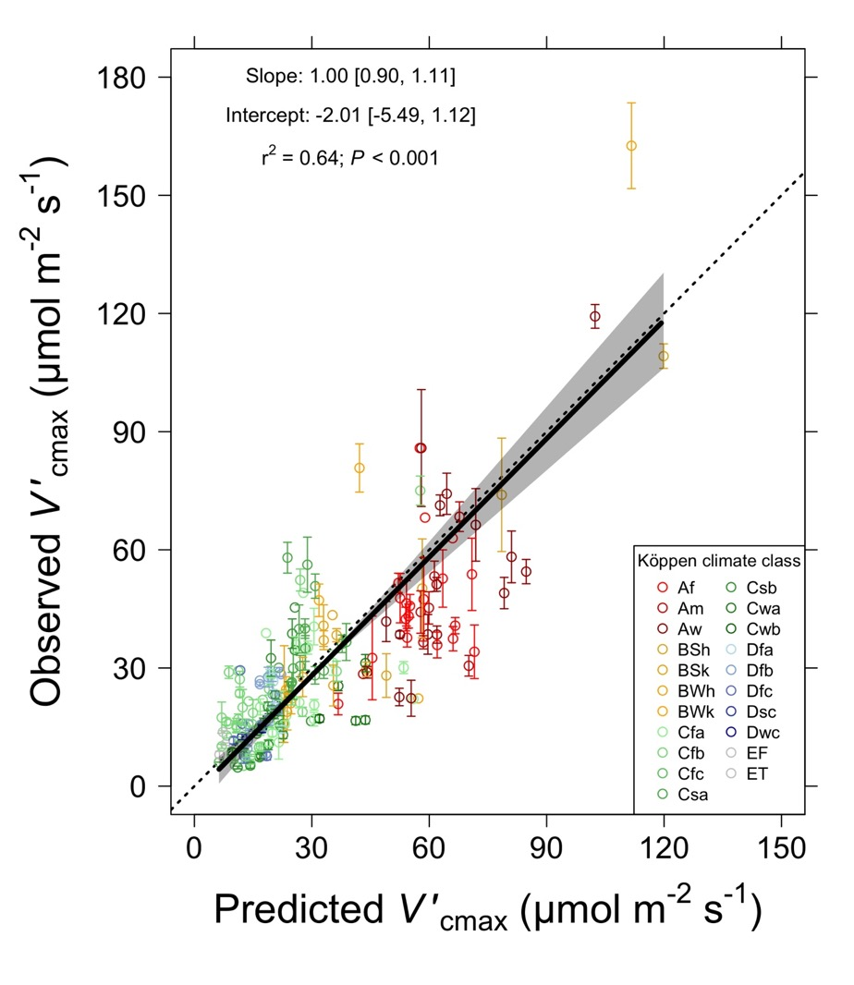
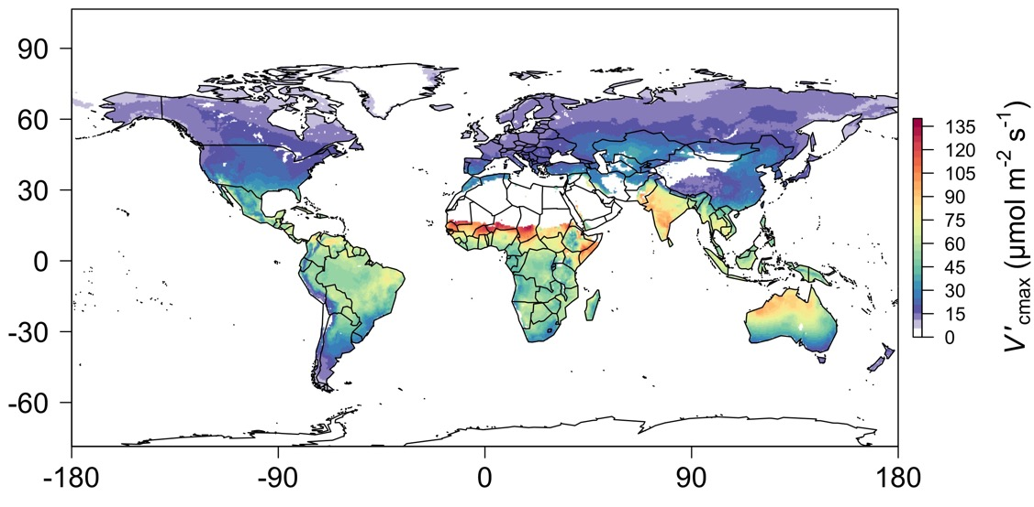
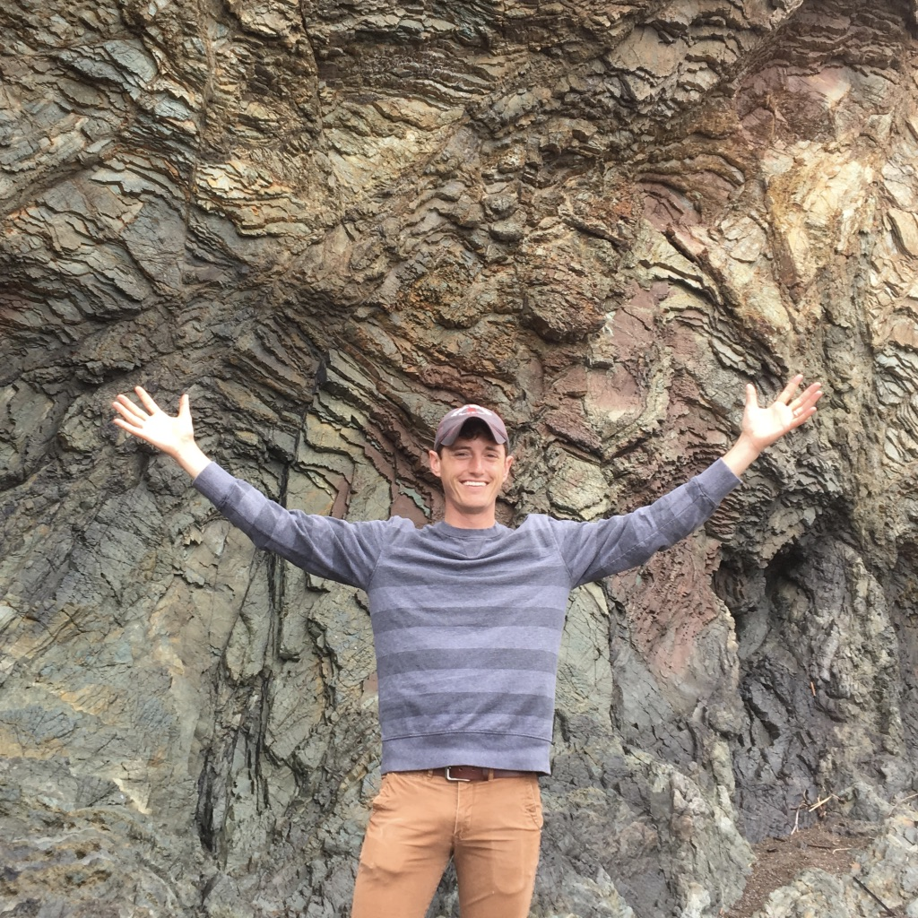
When starting the lab in 2017, I knew I had the answer!
Smith et al. (2019)

Slide 10
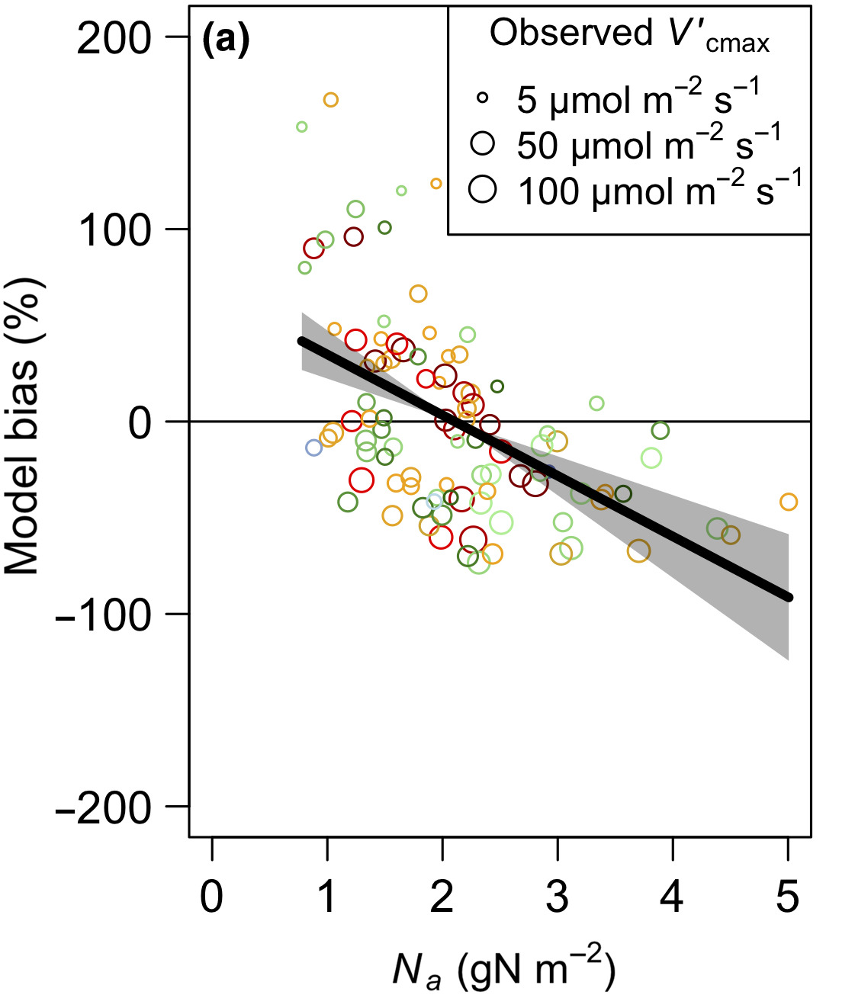
Not everyone agreed

Slide 11
Lesson: read with, discuss with, debate with, and listen to mentees

Slide 12
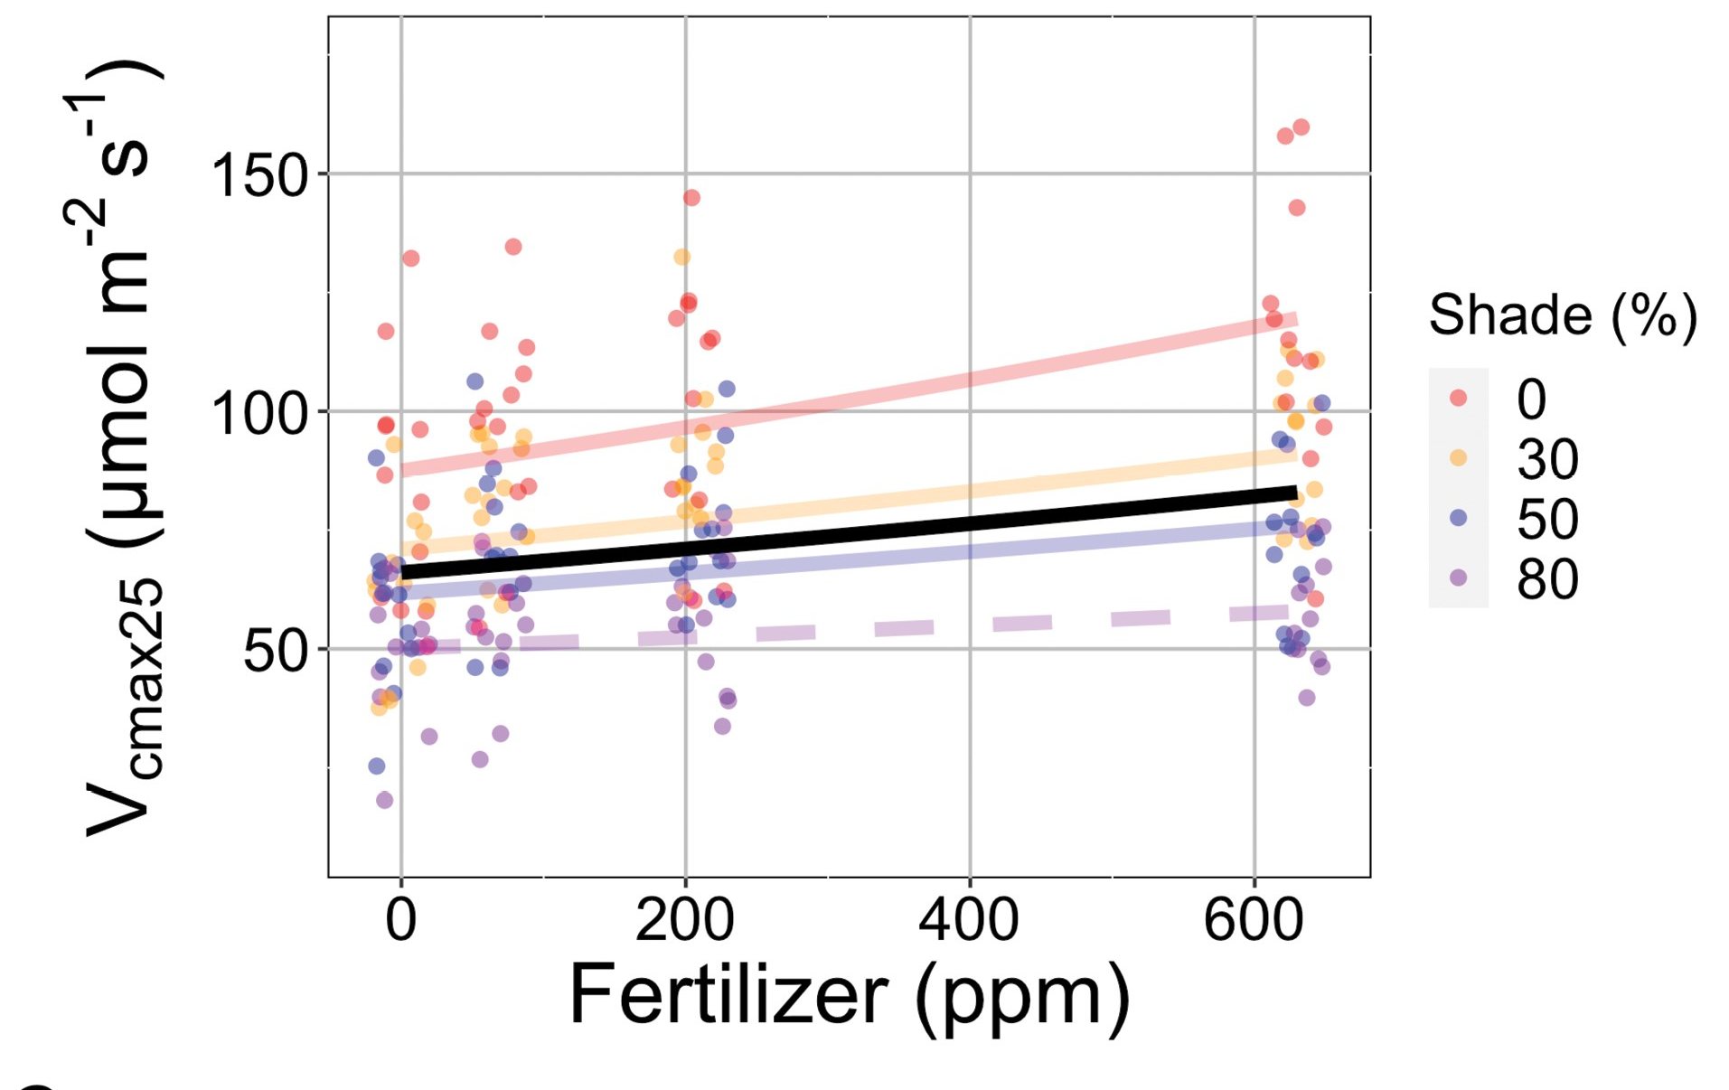
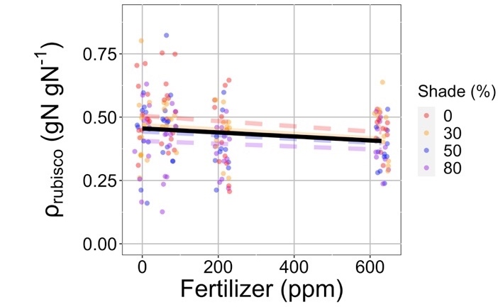
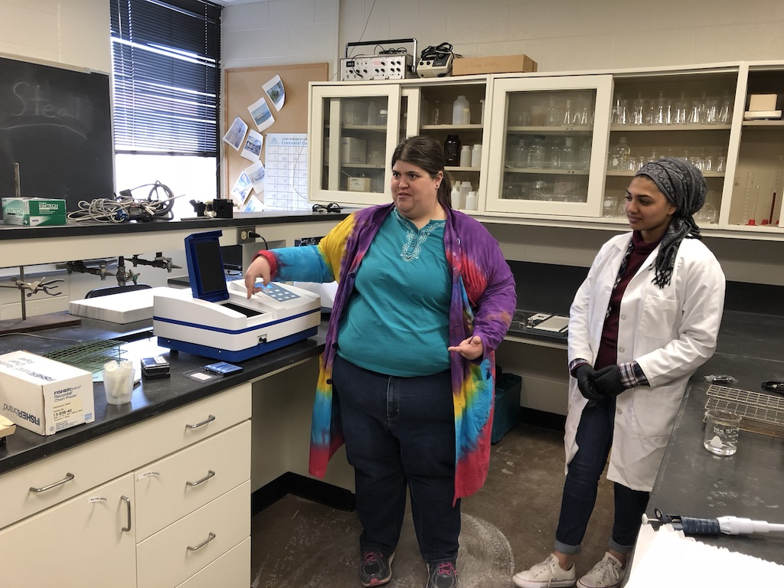
Result: now are clarifying how nutrient availability and nutrient demand influence photosynthesis
Waring et al. (2023)

Slide 13
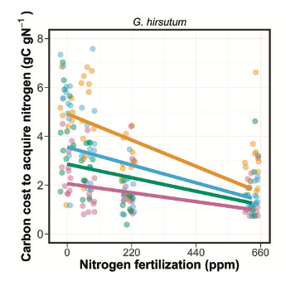
Result: new ideas can identify mechanisms
Perkowski et al. (2021)

Slide 14
Lesson: reserve and prioritize time to teach and train
Notes:
Not only fulfilling, but it helps you to learn

Slide 15
Lesson: value different skillsets and ideas

Slide 16
Lesson: help mentees achieve their goals, not yours
Notes:
Not only fulfilling, but it helps you to learn

Slide 17
Lesson: go slow

Slide 18
Lesson: be humble, be kind

